Slide 1
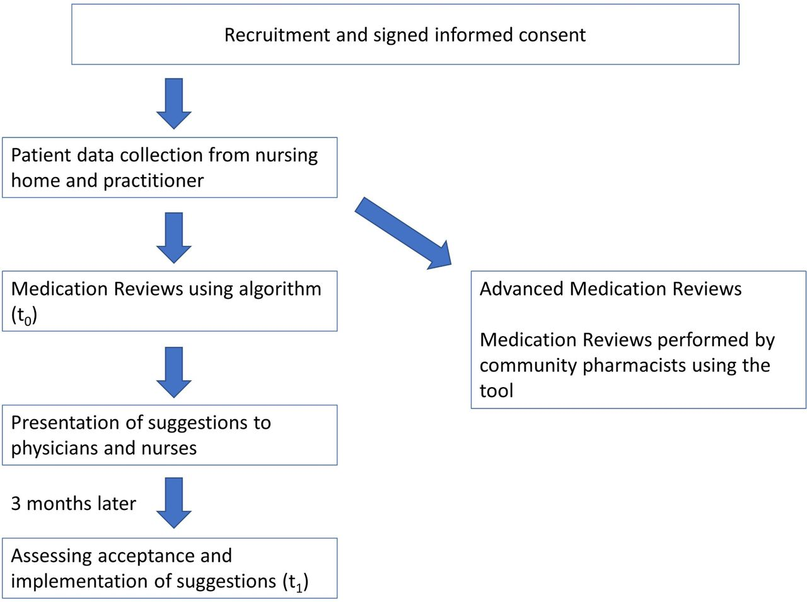
Title
Author(s) and credentials
BACKGROUND
Summarize relevant global data and statistics.
Review relevant current literature and address any knowledge gaps.
Discuss the current state at our institution/community comparing and contrasting this to the current literature and data/statistics reviewed above.
Discuss how this issue was identified and the reason for doing the project.
METHODS
Describe the study design: how was it conducted?
Talk about subjects: how were they identified, sampling techniques, inclusion/exclusion criteria, instruments used, data collection, planned statistical analysis, and timelines.
Provide graphical elements if possible: photos, tables or illustrations of methods if relevant. An example of a possible graphic is depicted below.
State that the study received IRB approval.
Do not include results.
RESULTS
Present an objective description of the data and results.
Address the stated Objectives (in the order listed under the objectives section).
List pre and post intervention data with appropriate statistical analysis.
Provide graphs (with data table), figures, charts or tables to visually communicate your results.
Address any unexpected results.
CONCLUSIONS
Be sure they are supported by your results and are drawn from the outcomes and aims/objectives.
State the changes that will be made based on the study results, recommendations for actions, lessons learned, further study, direction or next steps.
Share your dissemination plans.
DISCLOSURES
Authors of this presentation have the following to disclose regarding possible financial or personal relationships with commercial entities that may have a direct or indirect interest in the subject matter of this presentation.
PURPOSE
In 1 -2 sentences, succinctly state the purpose of your study.
Title
Label
OBJECTIVES
Primary Objective
  State here
Secondary Objective(s)
  State here
  State here
  State here
Label
REFERENCES
Make sure they are consistent in format.
If not otherwise directed, model after APA.
Author, A. (Publication Year). Article title. Periodical Title, Volume(Issue), pp.-pp
Caption
DISCUSSION
Analyze and interpret the results.
Relate the findings to previous research.
Mention impact on finances and patient care.
Address limitations to generalization of the results.
Discuss implementation and sustainability issues.
ACKNOWLEDGEMENTS
Acknowledge anyone who helped with the project or poster that did not meet authorship criteria.
Include sources used on the poster such as images or quotes.
Notes:
Poster Presentation Tips
Text: Use a minimal amount of text. Use one line statements or bullet points.
Graphics: Include simple charts, graphs, tables, drawings, symbols and photos to illustrate key points.
Font: Use large lettering – consider a minimum text size of 24-30 points. Text should be readable from 3 – 5 feet away.
Format: keep text boxes in the order they are currently listed. Change the size, column placement to fit the content presented. (IE, move the start of the results section to under the methods, etc.)
Development: Create an initial draft, then review. In addition to a mentor, consider asking others outside of the project to offer suggestions. The more input – the better the poster!

